Slide 1
Chapter 2
Sources of Information

Slide 2
Agenda
Research Versus Your Experience
Research Versus Your Intuition
Research Sources
Research Activity 2
Next time on PSY 270…

Slide 3
Research vs. Your Experience
Experience has no comparison group.
Experience is confounded.
Research is better than experience.
Research is probabilistic.

Slide 4
The Problem with Personal Experience
Relying on personal experience can over-inflate one possible outcome due to the lack of a comparison group
Comparison group – a group who receives a different treatment (or no treatment at all) to determine potential outcomes
Examples in-action: radical mastectomies, rage rooms, face tapping for anxiety

Slide 5
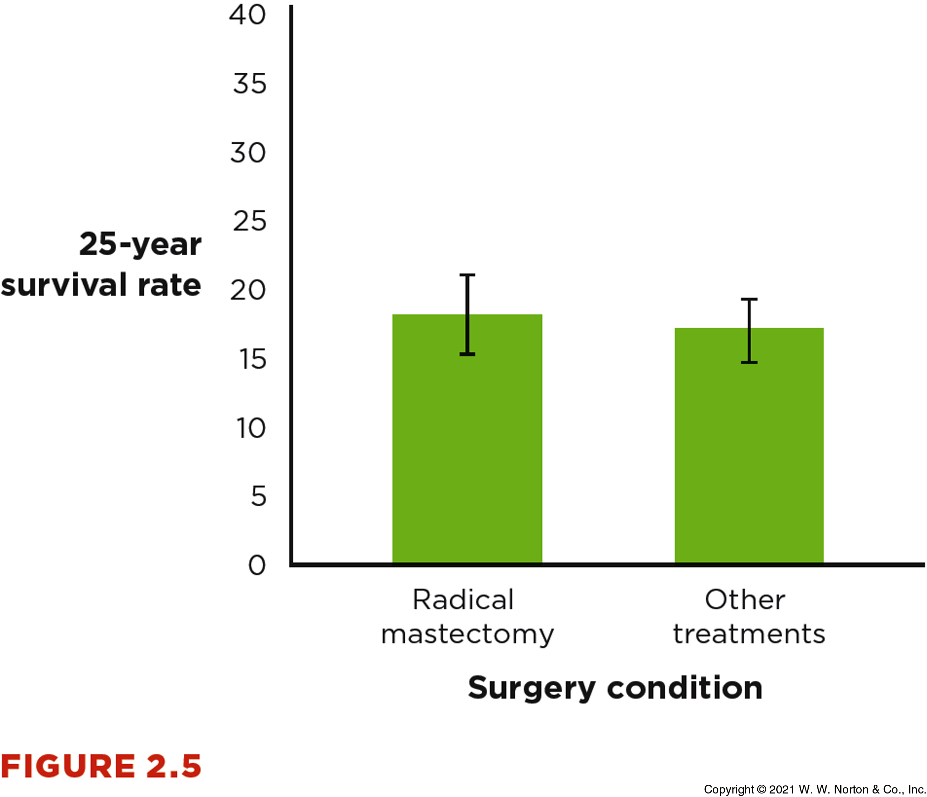
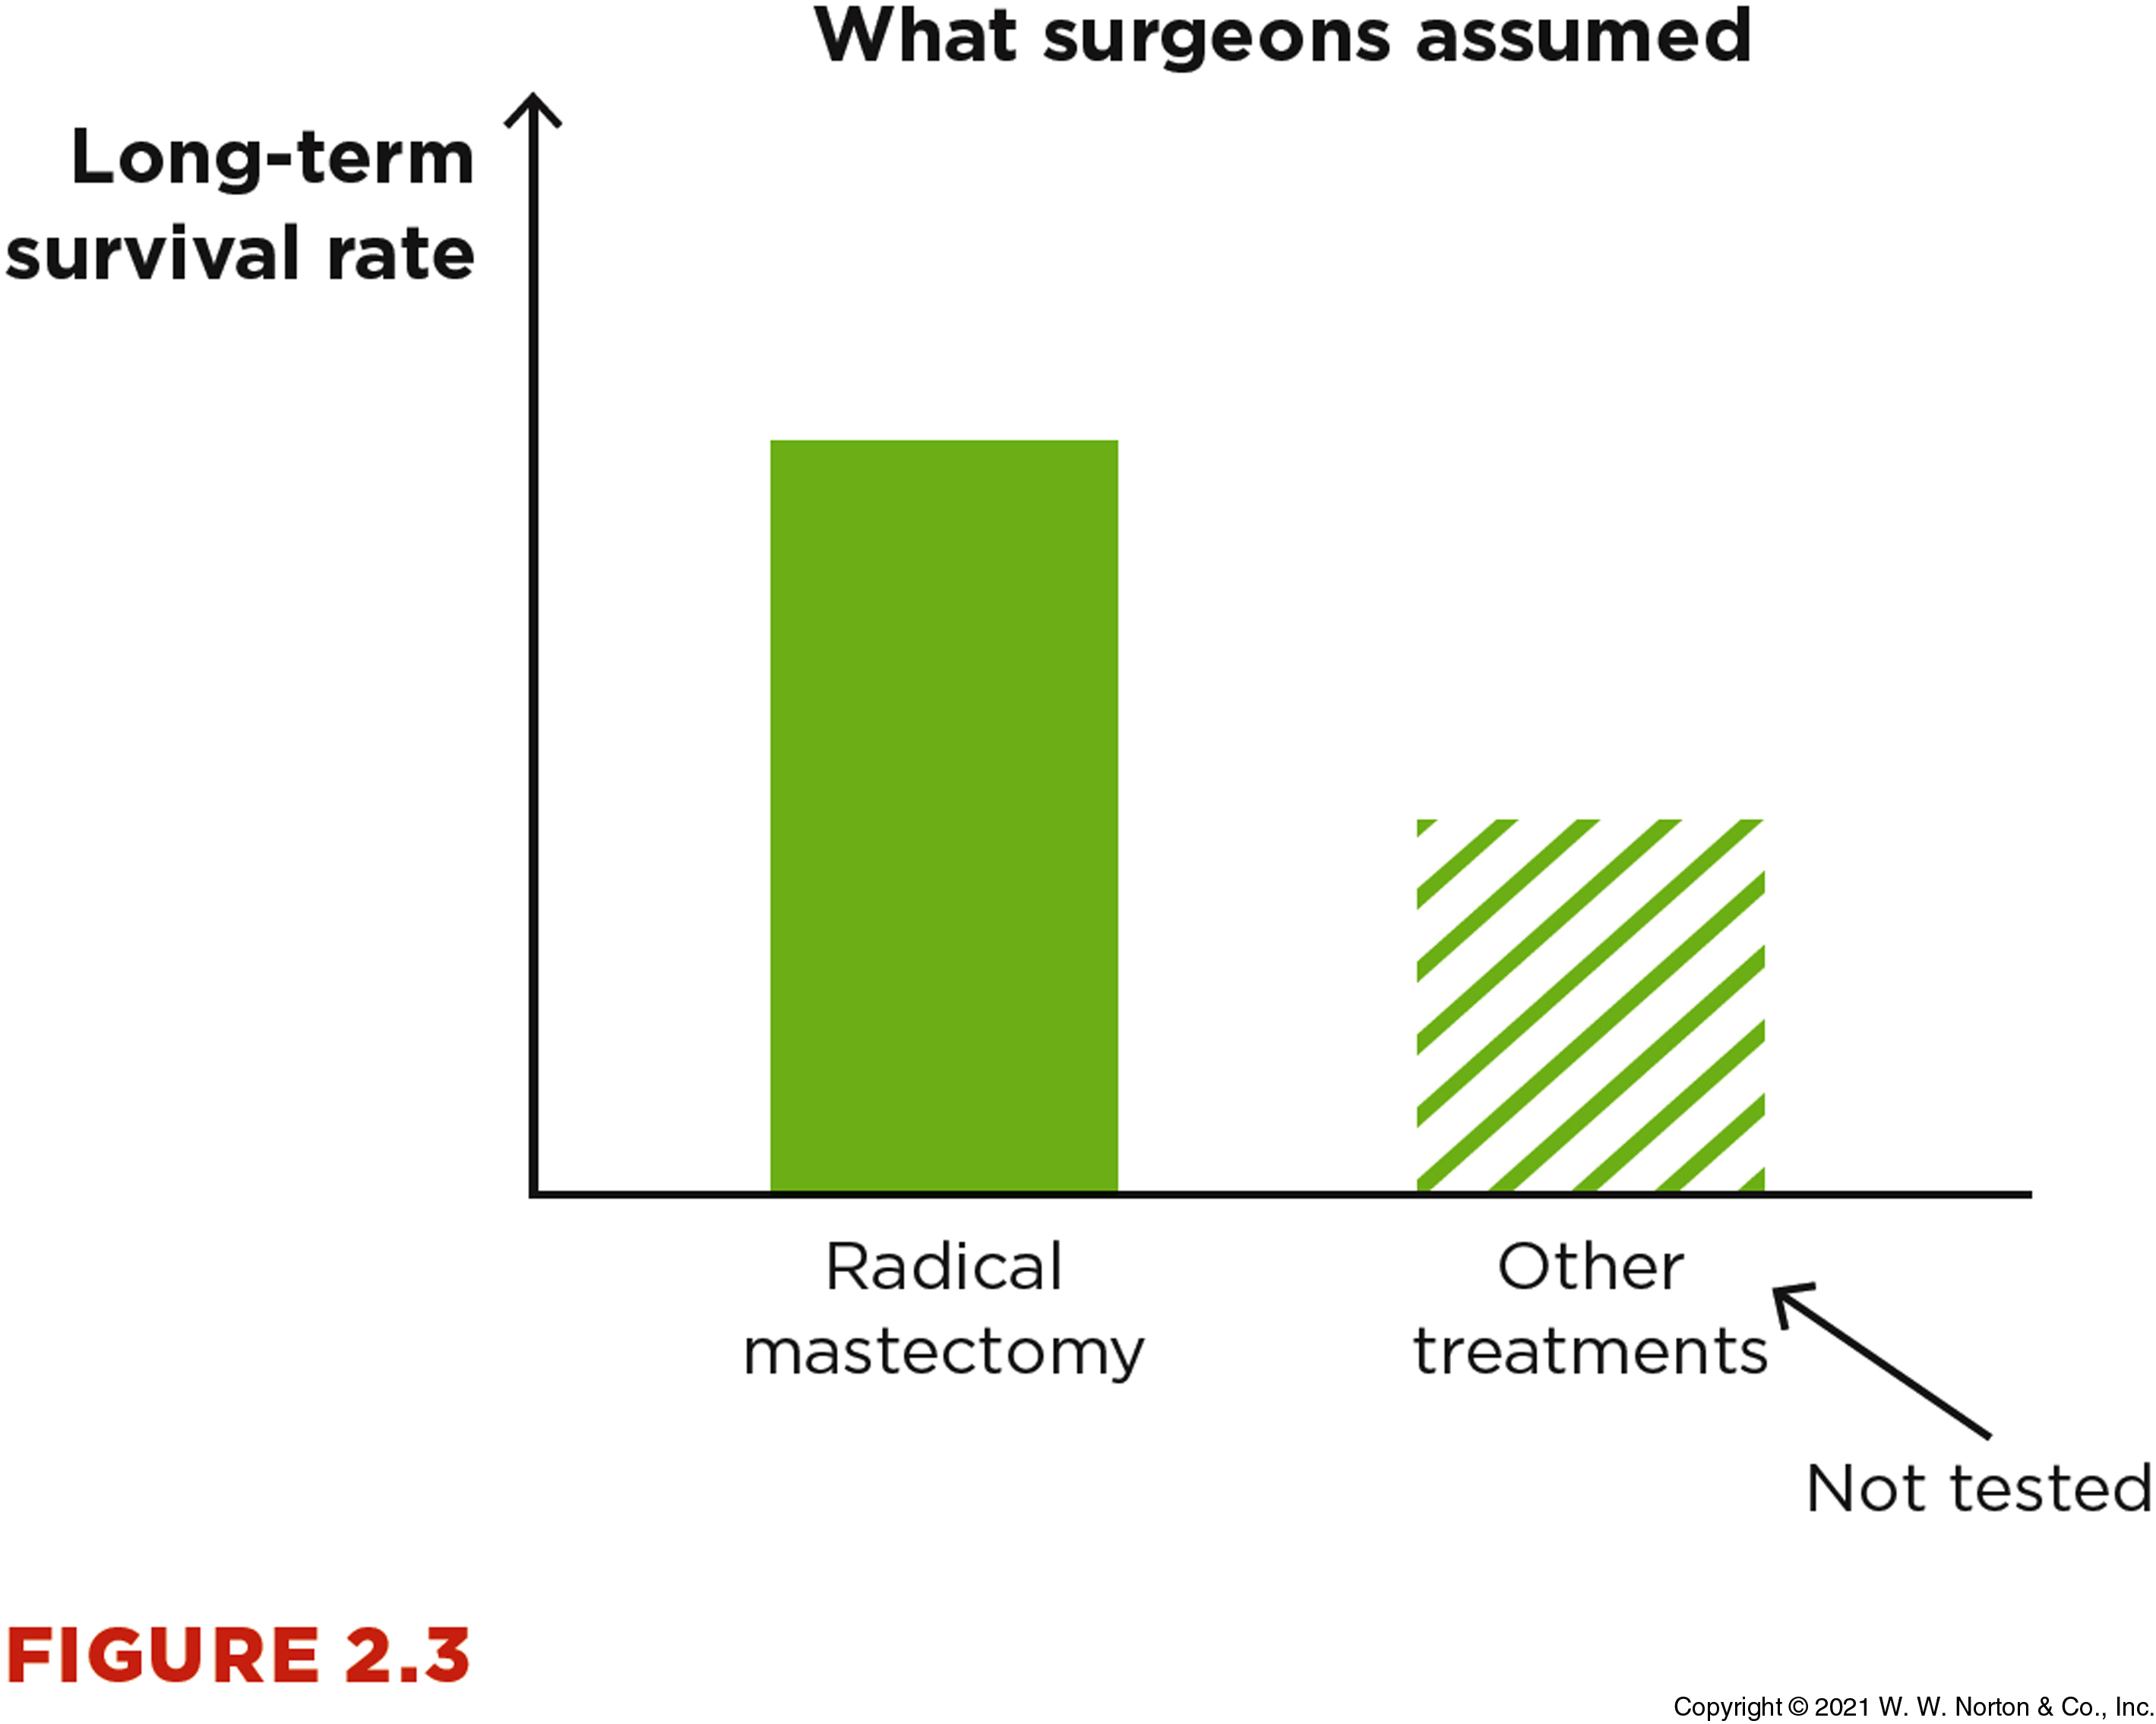
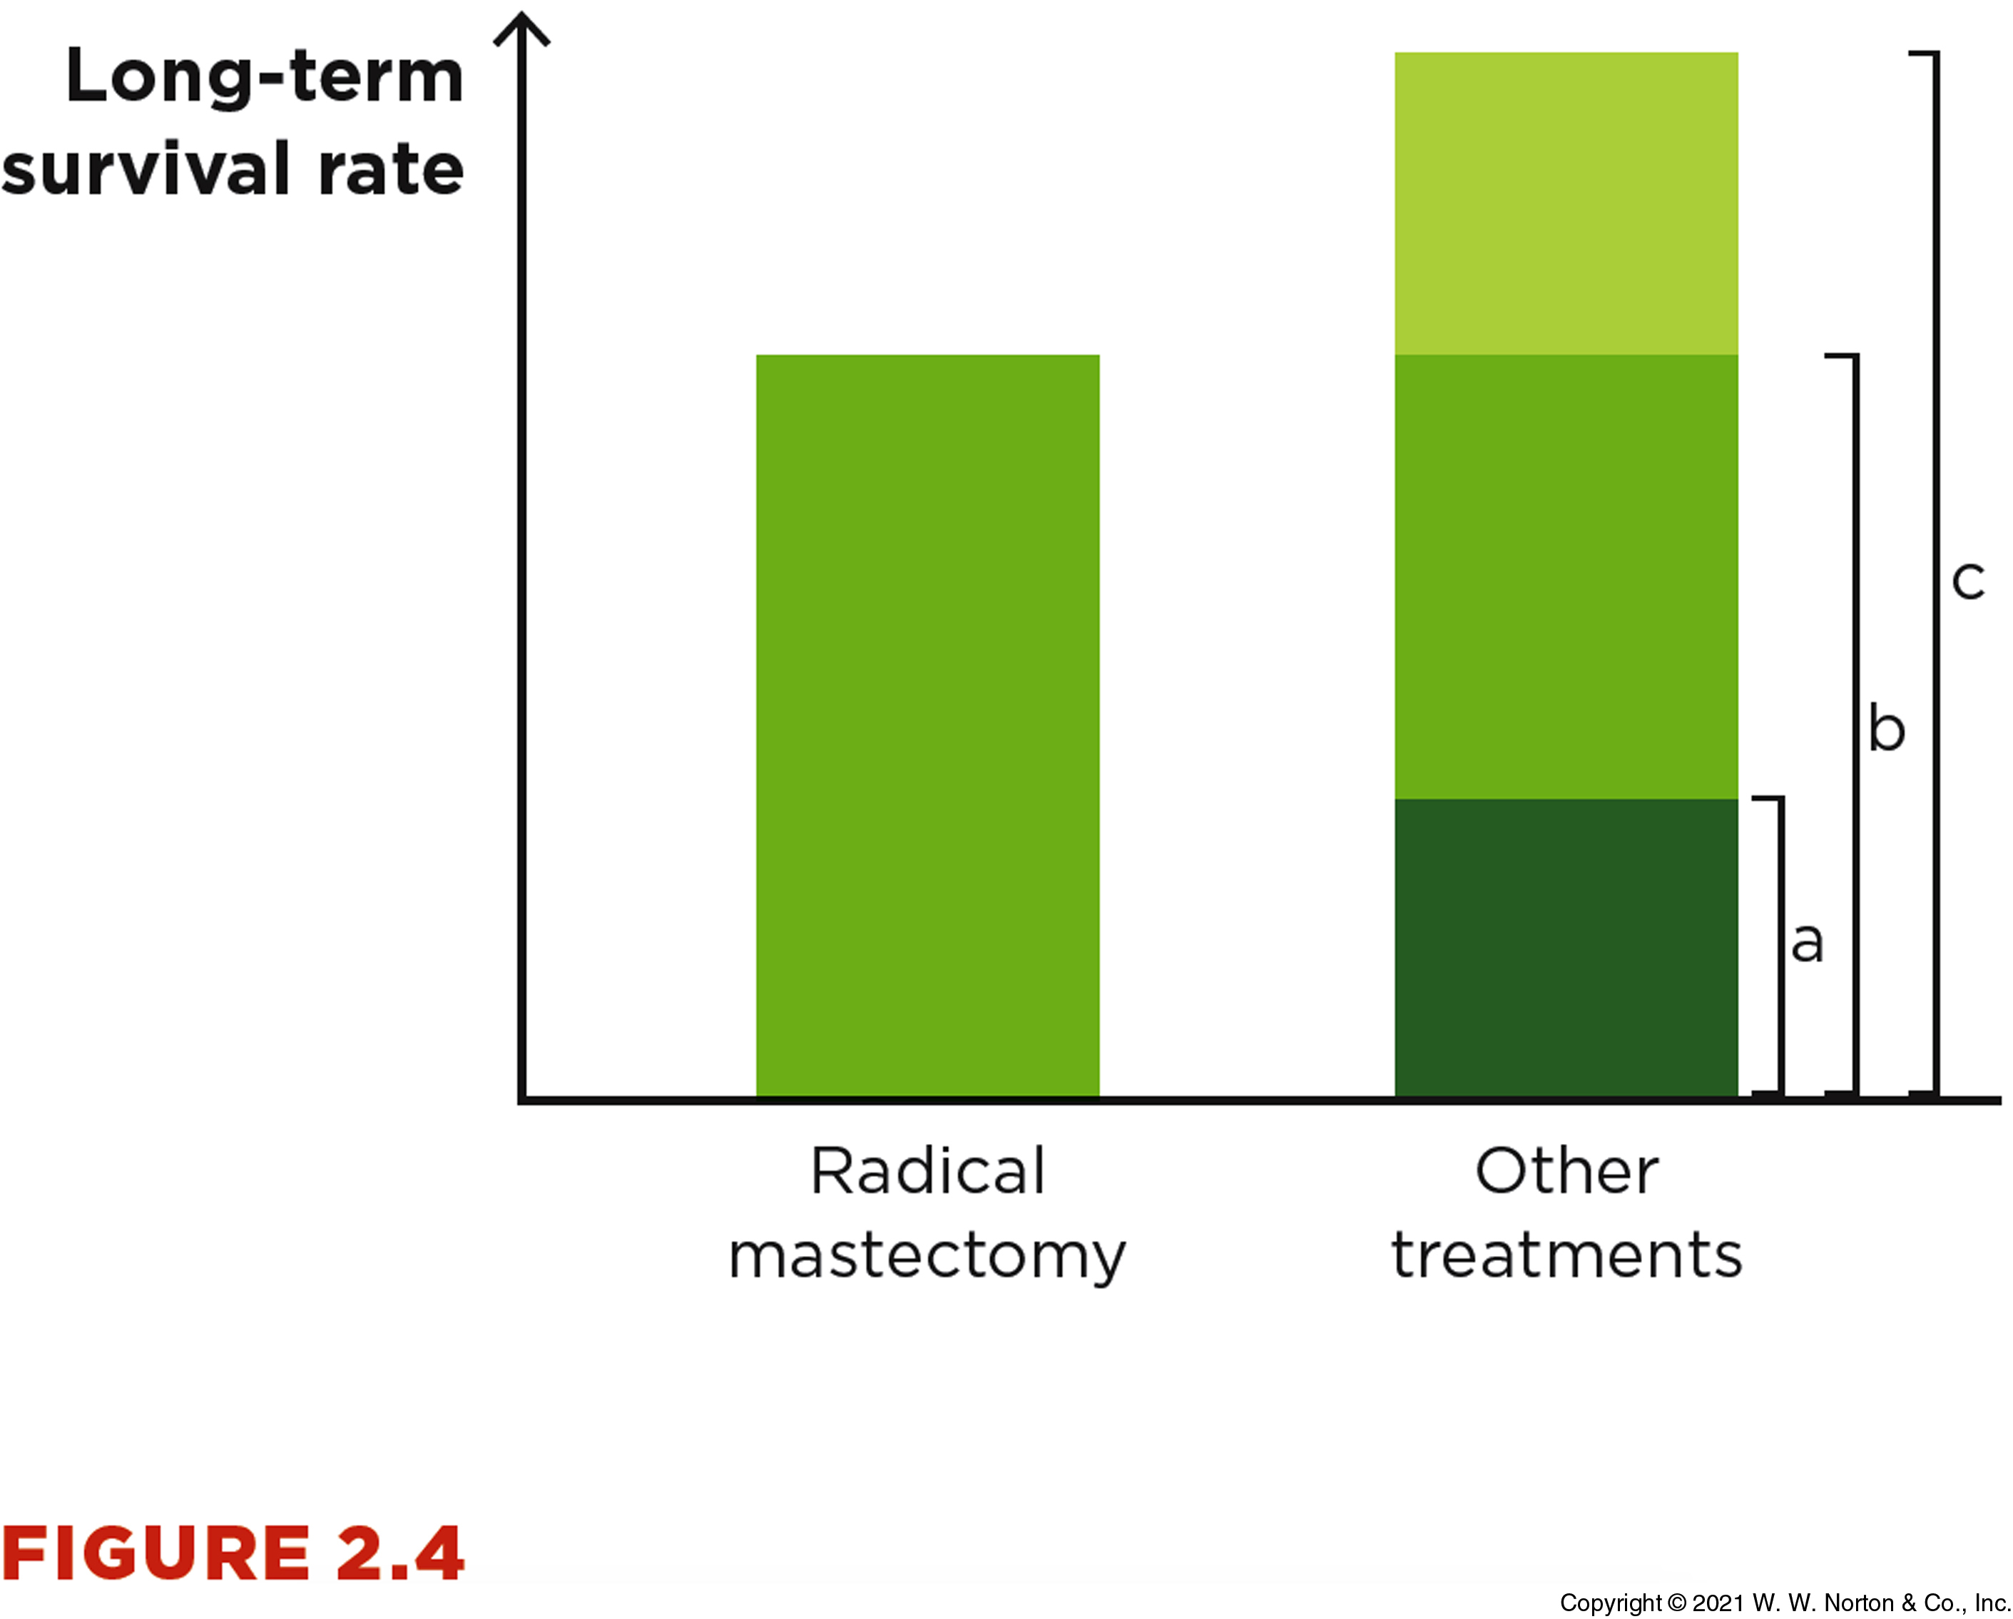
The Power of a Comparison Group

Slide 6
Experience is Confounded
When relying on personal experience, we can fall victim to confounds
  Ex: Believing rage rooms alleviate anger, when the “calming” affect may just be the drop in heart rate after exercise (not actually alleviating the anger itself)
Confounds – alternative variables that could explain phenomena
  confounded = confused
So, what do we do about confounds?
  Use a research setting where we can systematically look for patterns

Slide 7
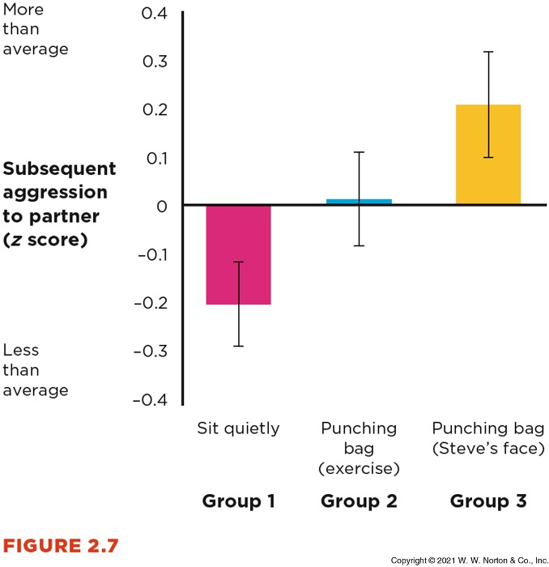
Research is Better than Experience
Bushman’s (2002) study on the effect of catharsis on aggression is a systematic comparison that controls for potential confounds.

Slide 8
Research Results are Probabilistic
Personal experience assumes my experience = all experiences
Research relies on a probabilistic approach
Probabilistic – based on the relative likelihood of something occurring, amongst all possibilities
In other words, research looks at an outcome as a possibility out of multiple outcomes, not a certainty

Slide 9
Research vs. Your Intuition
Ways in which intuition is biased
The intuitive thinker vs. the scientific reasoner

Slide 10
Ways that Intuition Can Be Biased
Being swayed by a good story
  Sounds logical ≠ true
Being persuaded by what easily comes to mind
Focusing on the evidence we expect
Being biased about being biased

Slide 11
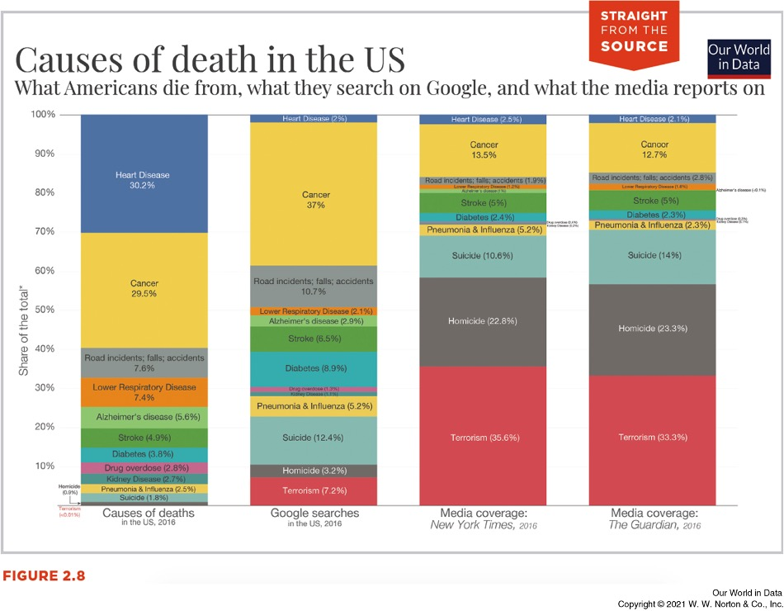
Ways That Intuition Can Be Biased
Being persuaded by what easily comes to mind
  Availability heuristic – the things that come to mind easily are more “available” to memory and can guide and/or bias our thinking
  The brain’s “recently viewed” links

Slide 12
Ways That Intuition Can Be Biased
Focusing on the evidence we expect to be true
  Confirmation bias – the tendency to focus on information we already believe to be true
  Ex: the worst cases come into the ER on the full moon
Being biased about being biased
  Bias blind spot – the belief that we are less likely to fall prep to biases than other people
  We don’t want to be vulnerable, so we convince ourselves that we would not make the same mistakes

Slide 13
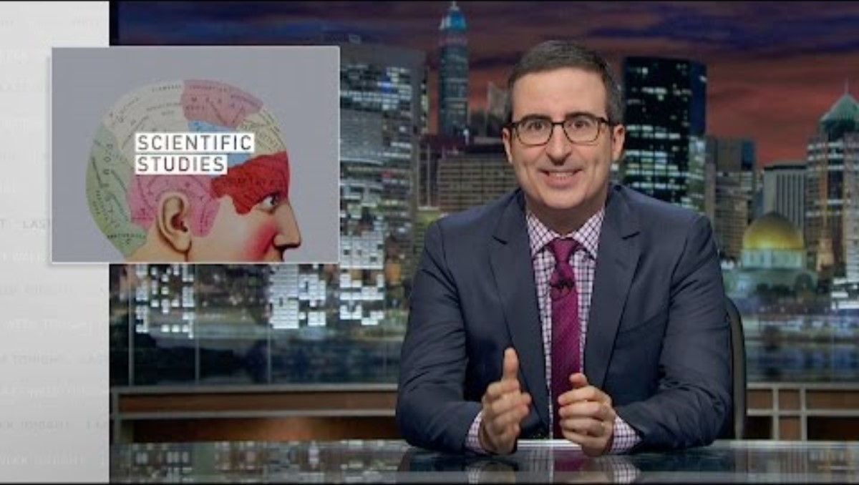
Intuition “Cherry-Picking”
Science progresses slowly, one study at a time.
We need to consider the full body of evidence.
We are not allowed to cherry-pick only the studies that make sense to us.
https://www.youtube.com/watch?v=0Rnq1NpHdmw

Slide 14
The Intuitive Thinker vs The Scientific Reasoner
We make mistakes when we base our reasoning on intuition rather than on empiricism.
Researchers create comparison groups and look at all the data.

Slide 15
The Intuitive Thinker vs. The Scientific Reasoner
So, how do we be scientific reasoners?
Consulting scientific sources
Finding legitimate scientific sources
Reading the research
Legitimate journalism versus disinformation

Slide 16
Research Sources
Sources of Information
Consulting Sources
Finding Legitimate Sources
Reading with a Purpose
Disinformation

Slide 17
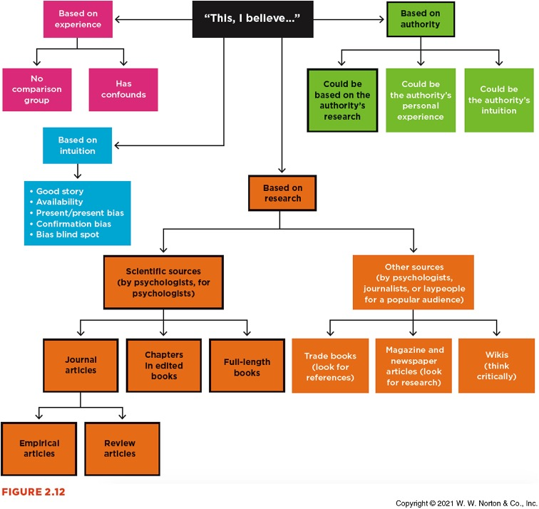
Sources of Information
The black-outlined boxes are the best scientific approach

Slide 18
Consulting Scientific Sources
Journal articles are the most important source for psychology
Empirical journal article – A paper reporting the method and results from an experiment (or series of experiments) for the first time
Review journal article – A paper summarizing all the published studies that have been conducted in that particular research area
Meta-analysis – A paper statistically evaluating the information reported across multiple other empirical journal articles

Slide 19
Consulting Scientific Sources
Other scientific sources include:
Chapters in edited books (each chapter is written by different authors)
Full length books (written by one author)
  This is rather rare in psychology

Slide 20
Finding Legitimate Scientific Sources
PsycINFO
  Great filtering options; psychology focused, and most likely to have peer-reviewed sources
Google Scholar
  All encompassing, but poor filtering
PsyArXiv
  Based in open science mindset, but does not have peer-review
Concerns:
  Predatory journals
  Paywalled vs open access
  Impact factors (quality matters)

Slide 21
Reading with a Purpose
Components of an empirical journal article
  Abstract
  Introduction
  Method
  Results
  Discussion
  References
Approach sections with a goal in mind:
  What is the argument?
  What is the evidence to support the argument?

Slide 22
Disinformation
Some information may be incorrect by accident (ex: oversimplification)
Other times, the research is deliberately inaccurate
  Disinformation – the deliberate creation and sharing of information known to be false
A common example of disinformation is sharing information from a retracted paper
  Retracted – when the authors publicly state the paper is inaccurate
  Cool source for those interested: Retraction Watch

Slide 23
Combating Disinformation
Click restraint: Pause when a social media post triggers fear, anger, or vindication.
Lateral reading: Look for better coverage on credible platforms.

Slide 24
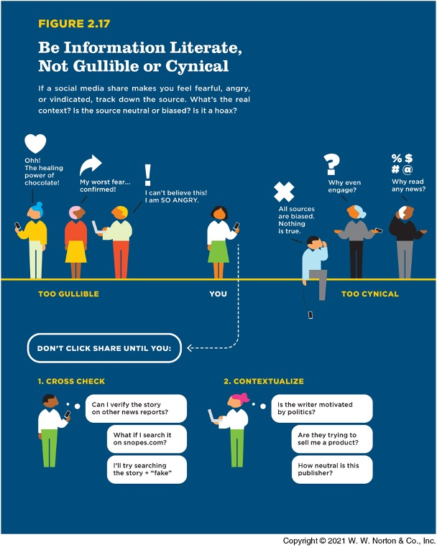
Gullible, Cynical, or Literate?

